Slide 1
SSW345 Model-Based Software Engineering
Node.js Intro
Prof. Ye Yang

Slide 2
Recall: Types of System Interactions
Four types of interactions between client/server
  Synchronous
  Asynchronous
  Deferred synchronous
  Asynchronous callback
A synchronous operation blocks a process till the operation completes.
  If a request is waiting, all other requests would be halted for a long time.
  Blocking I/O handle concurrency by having more threads.
  More threads = more memory and CPU context-switching.
An asynchronous operation is non-blocking and only initiates the operation, and the caller could discover completion by some mechanism.
  Non-blocking IO without language support makes code hard to read/write.

Slide 3
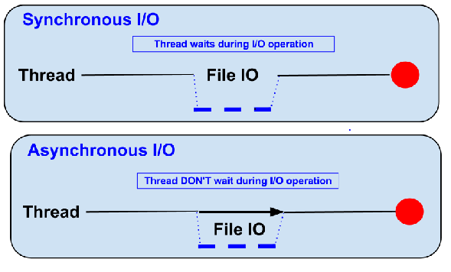
Blocking vs Non-Blocking……
Example :: Read data from file and show data

Slide 4
Blocking…..
● Read data from file
● Show data
● Do other tasks
    var data = fs.readFileSync( “test.txt” );
    console.log( data );
    console.log( “Do other tasks” );

Slide 5
Non-Blocking……
callbacks
● Read data from file
When read data completed, show data
● Do other tasks
    fs.readFile( “test.txt”, function( err, data ) {
    console.log(data);
    });

Slide 6
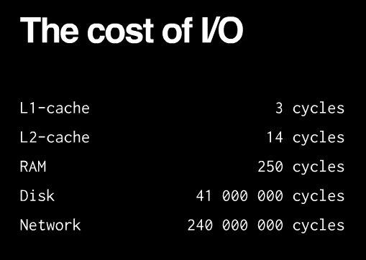
Modern Web Applications
Mostly I/O bound by nature.
Blocking I/O is not scalable.
  Each I/O would hold up a thread.
For example
  if 1000 I/O calls happening, then there are at least 1000 OS threads created, consuming 1000 * 10 MB of memory, context-switching in the cpu would also be really high.
This is an inefficient concurrency model.
Most languages/frameworks are not designed with this in mind.
Notes:
I/O-bound operations usually involves interactions with disks/drives. Examples include database access and file system operations. Some other related concepts include CPU-bound, memory-bound, etc. A good way to determine whether an operation belongs to I/O-bound, CPU-bound, or others is to check by increasing which resource would that specific operation have a better performance. For example, if an operation would go noticeably faster if CPU power is increased, then it is CPU-bound.

Slide 7
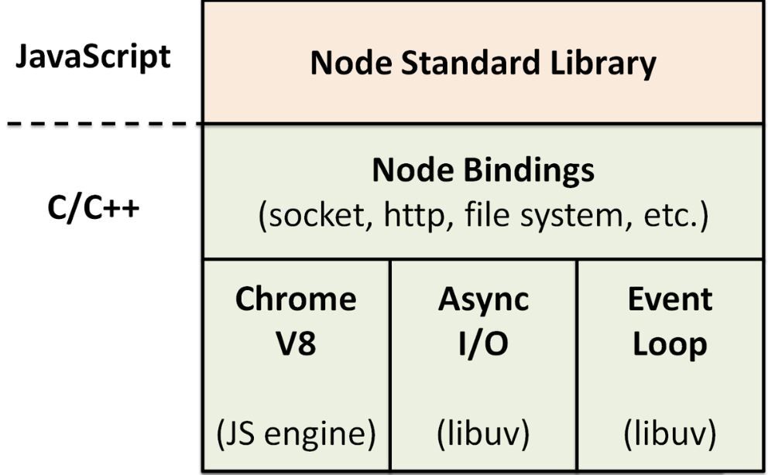
What is Node.js?
Node.js
  Javascript running on the server.
  Run on Chrome V8 javascript engine.
  Core is libuv, written in C.
    Single-threaded event loop
    Non-blocking I/O
  NPM for package management.
  Current version: 13.12.0
  URL: http://nodejs.org/en
Swiss army knife for network Related stuffs
Can handle thousands of Concurrent connections with Minimal overhead (cpu/memory) on a single process
Node.js Architecture
Notes:
libuv, which is the absolute core of the high performance asynchronous networking that Node.js is famous for, is written in pure C.

Slide 8
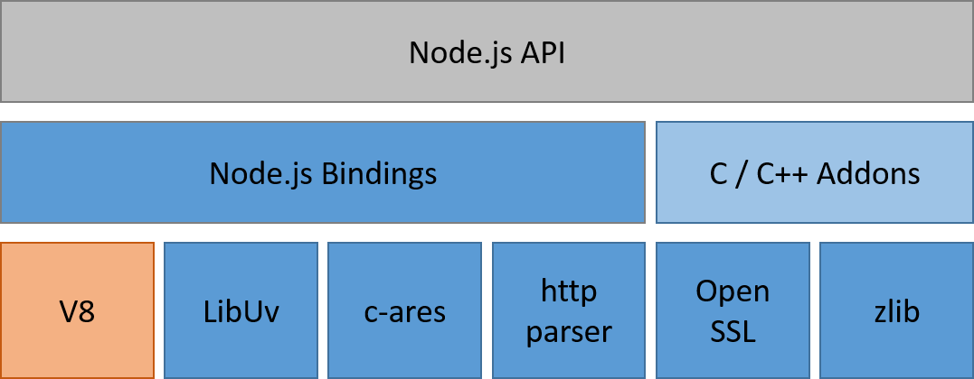
Node.js Architecture
JavaScript
C/C++
The reason that there are so many C/C++ code/libraries is simple: they are fast.
Notes:
you probably have noticed by this time that Node.js is written in both JavaScript and C/C++. The reason that there are so many C/C++ code/libraries is simple: they are fast.
And normally code written in different languages cannot be communicate with each other. Not without bindings.

Slide 9
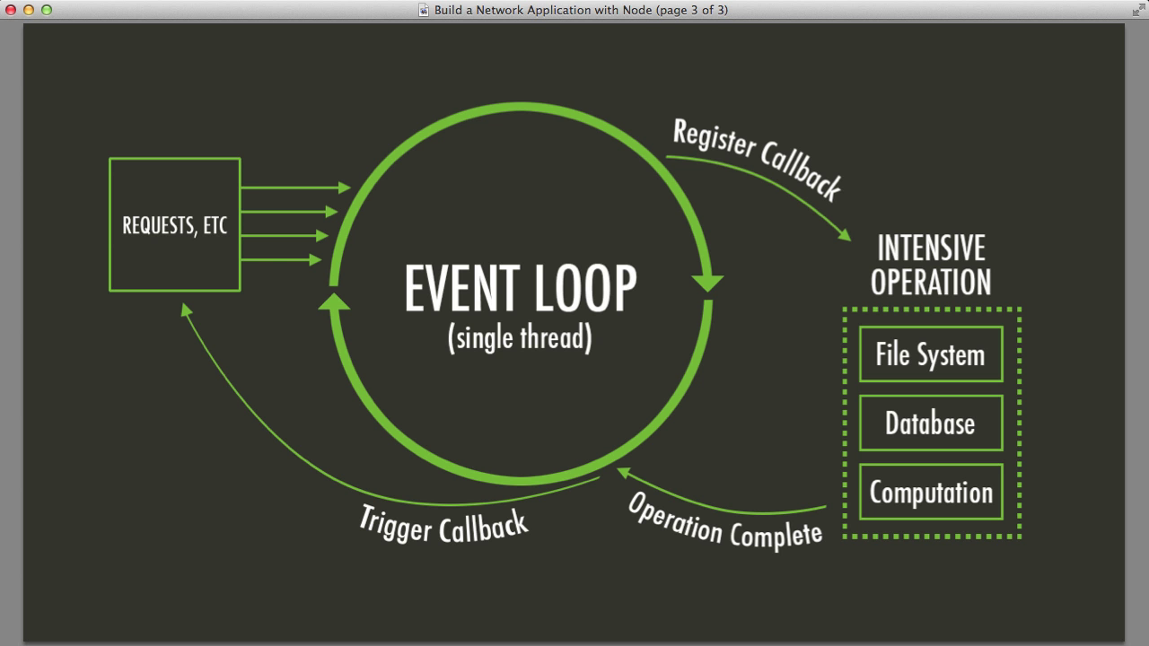
Node.js Event Loop
Ev
Event-driven: All operations are registered to Node.js as events, waiting to be triggered
Either by the main application or requests.
Avoid synchronous code at all costs because it blocks the event loop
Which means: callbacks, callbacks, and more callbacks
Notes:
typically, in almost all modern systems, after the main application kicks off, processes are initiated by incoming requests. However, how things go from there differ, sometimes drastically, among different technologies. Typical implementations handle a request procedurally: a thread is spawn for a request; operations are done one after another; if an operation is slow, all following operations halts on that thread; when all operations complete successfully, a response to returned. However, in Node.js, all operations are registered to Node.js as events, waiting to be triggered, either by the main application or requests.

Slide 10
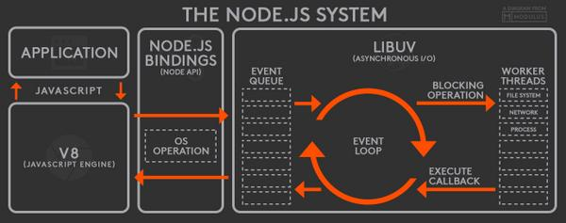
Putting Everything Together
Notes:
Now that we have a high-level overview of Node.js’ components, we’ll investigate its workflow to get a better sense of its architecture and how different components interact with one another.
When a Node.js application starts running, the V8 engine will run the application code you write. Objects in your application will keep a list of observers (functions registered to events). These observers will get notified when their respective events are emitted.
When an event is emitted, its callback function will be enqueued into an event queue. As long as there are remaining events in the queue, the event loop will keep dequeuing events in the queue and putting them onto the call stack. It should be noted that only when the previous event is processed (the call stack is cleared) will the event loop put the next event onto the call stack.
On the call stack, when an I/O operation is encountered, it will be handed over to libuv for processing. By default, libuv maintains a thread pool of four worker threads, although the number can be altered to add more threads. If a request is file-system I/O and DNS-related, then it will be assigned to the thread pool for processing; otherwise, for other requests such as networking, platform-specific mechanisms will be deployed to handle such requests (libuv design overview).
For I/O operations that make use of the thread pool (i.e. file I/O, DNS, etc.), the worker threads will interact with Node.js’ low-level libraries to perform operations such as database transaction, file system access, etc. When the processing is over, libuv will enqueue the event back into the event queue again for the main tread to work on. During the time that libuv handles asynchronous I/O operations, the main thread does not wait for the outcome of processing, but moves on instead. The event returned by libuv will have the opportunity to be handled by the main thread again when it is put back onto the call stack by the event loop.This completes a the life cycle of an event in a Node.js application.

Slide 11
Callbacks
A Callback is simply a function passed as an argument to another function which will then use it (call it back).
Error first callbacks: By convention, the first argument of a callback function is an error.
fs.readFile(funFileName, function(err, file) {
if(err)
handleError(err);
console.log("file: ", file)
})

Slide 12
Node.js is not…
Another language
  A language is just a minimal set of rules for doing things
    Programming language: to be compiled
    Scripting language: to be interpreted
  Node.js: based on JavaScript language
Another framework
  A framework is a collection of useful tools written for a particular programming language
    To make coding easy and organized
    Example frameworks: Angular, Spring
  Node.js: based on Chrome's V8 JavaScript engine
Multi-thread
  Single thread with outstanding, non-blocking I/O performance.
Notes:
JavaScript is well known for client-side scripts running inside the browser
node.js is JavaScript running on the server-side
SSJS -> Server-Side JavaScript
Use a language you know
Use the same language for client side and server side

Slide 13
The idea behind Node.js…
Perform asynchronous processing on single thread
  instead of classical multithread processing
  minimize overhead & latency, maximize scalability
Scale horizontally instead of vertically
Ideal for applications
  that serve a lot of requests but do not use/need lots of computational power per request
Not so ideal for heavy calculations
  e.g. massive parallel computing
Also: Less problems with concurrency

Slide 14
When to use it ?
Chat/Messaging
Real-time Applications
Intelligent Proxies
High Concurrency Applications
Communication Hubs
Coordinators

Slide 15
Node.js for….
Web application
Websocket server
Ad server
Proxy server
Streaming server
Fast file upload client
Any Real-time data apps
Anything with high I/O

Slide 16
File package.json…..
Project information
• Name
• Version
• Dependencies
• Licence
• Main file
Etc...

Slide 17
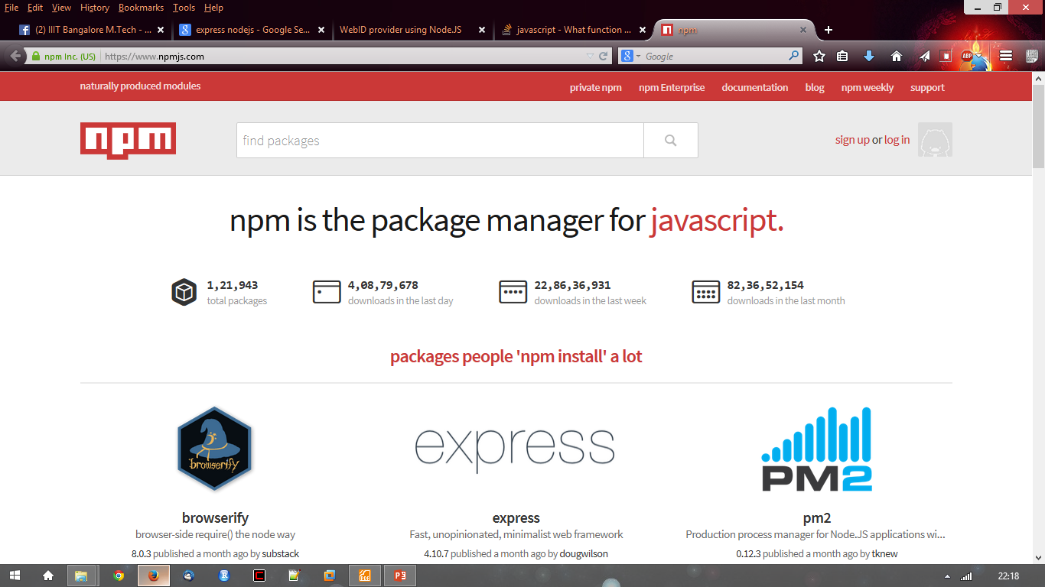
Node.js Modules…..
● https://npmjs.org/
● # of modules = 1,21,943

Slide 18
npm
Used to install node program/modules.
Specify dependencies in a file call package.json.
Modules get installed into node_modules folder.
NPM version 5 generate package.lock.json to guarantee similar dependencies are always restored.
Alternative to npm
  Yarn: http://yarnpkg.com/

Slide 19
Install module…..
$npm install <module name>

Slide 20
Using module…..
Requiring a module
  var http = require(‘http’);
  var fs = require(‘fs’);
  var express = require(‘express’);
Creating and Exporting a Module
  module.exports = module_name;

Slide 21
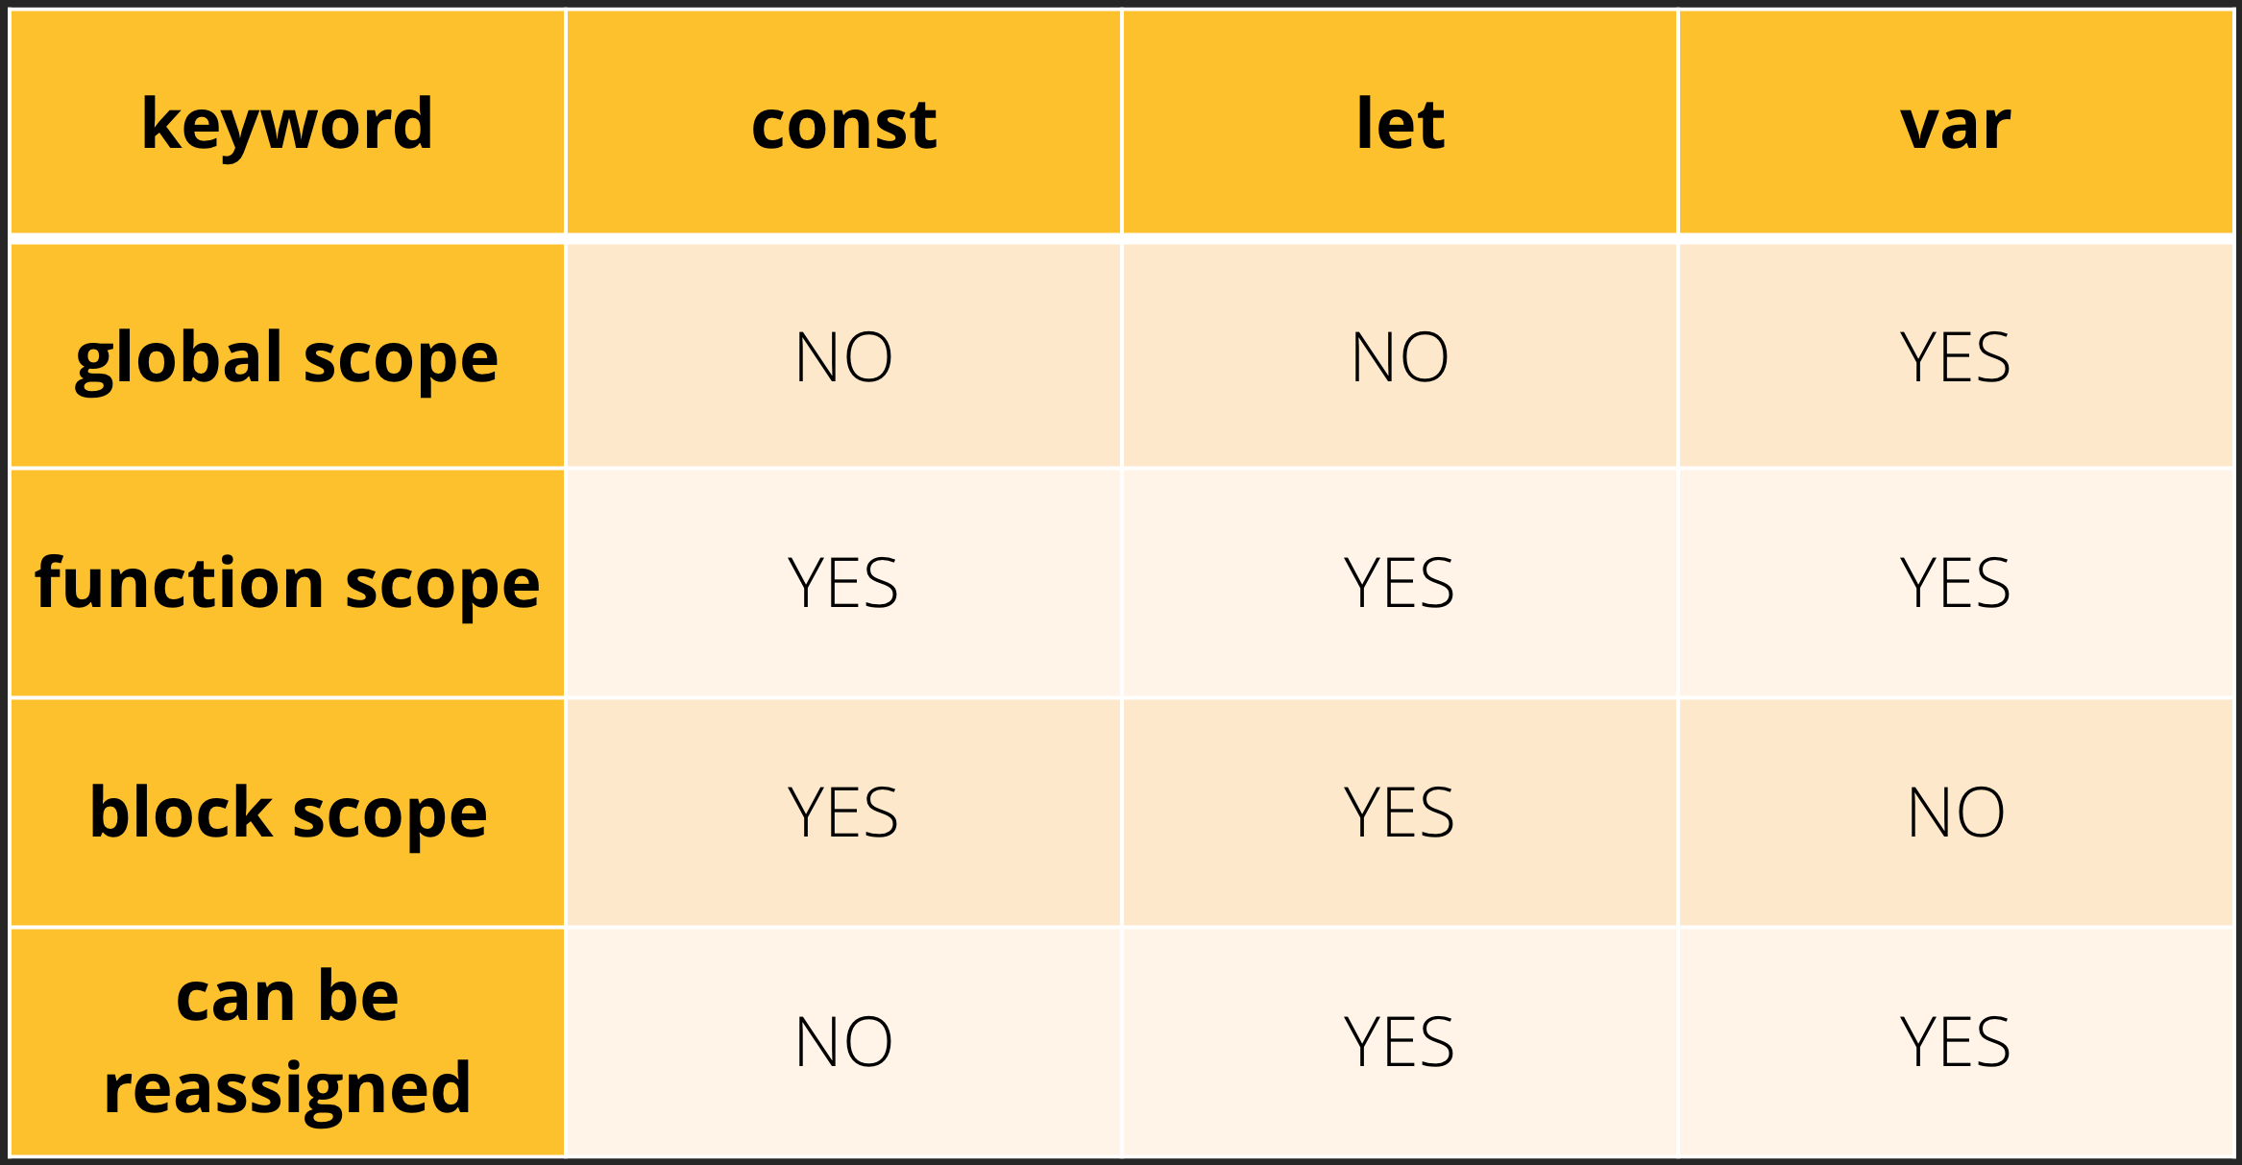
var, let, const
ES6 Convention:
  Use “const” by default
  Use “let” if you have to rebind the value
  Use “var” to signal untouched legacy code

Slide 22
JavaScript function
A block of code designed to perform a particular task.
  Example:
Syntax:
  defined with the function keyword, followed by a name, followed by parentheses ().
    Function parameters are listed inside the parentheses () in the function definition.
    Function arguments are the values received by the function when it is invoked.
  Functions often compute a return value.
Function invocation
  When an event occurs (when a user clicks a button)
  When it is invoked (called) from JavaScript code
  Automatically (self invoked)
Arrow function: allow to write shorter function syntax
function myFunction(p1, p2) {
return p1 * p2; // The function returns the product of p1 and p2
}
hello = function() {
return "Hello World!";
}
hello = () => {
return "Hello World!";
}
Notes:
Why Functions?
You can reuse code: Define the code once, and use it many times.
You can use the same code many times with different arguments, to produce different results.

Slide 23

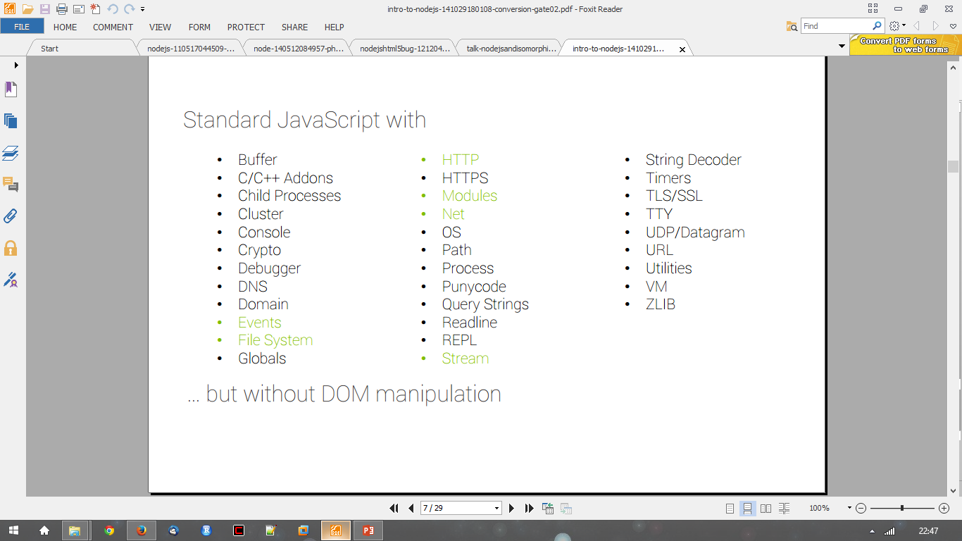
In NodeJS

Slide 24
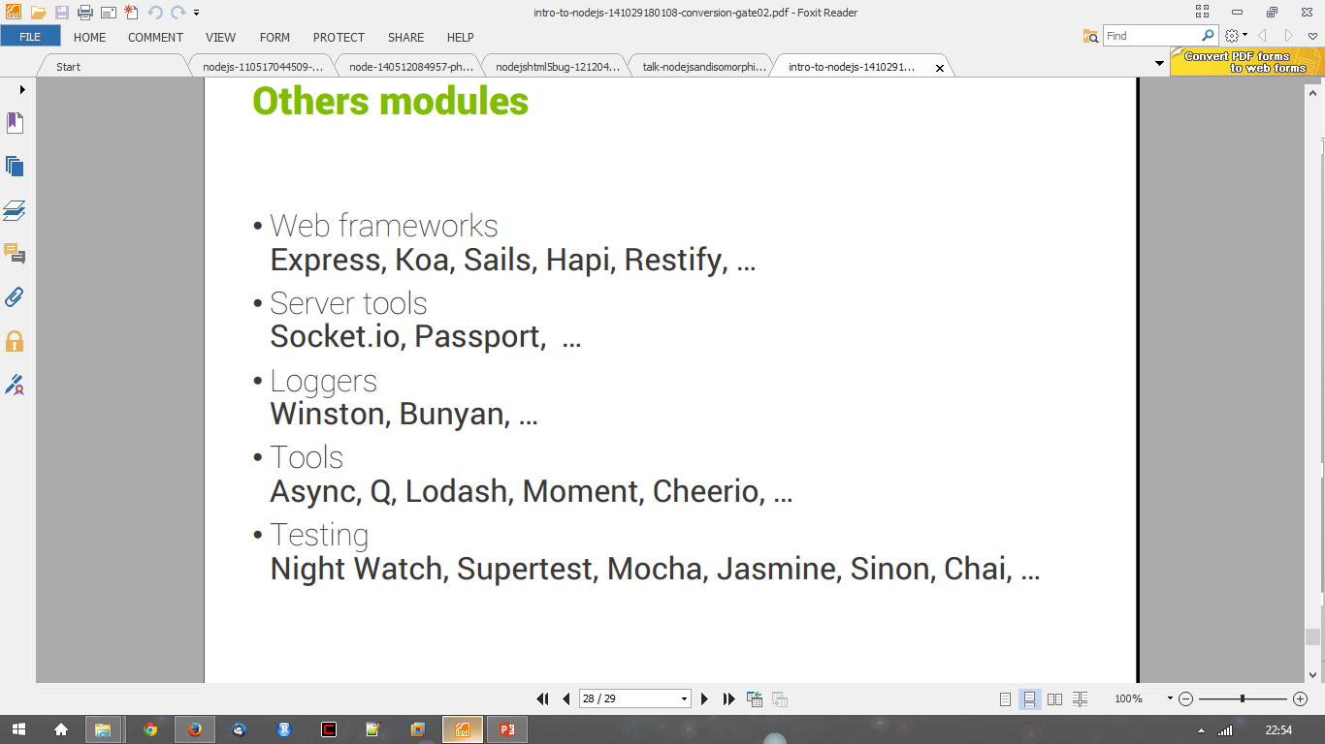
Others modules…..

Slide 25
Popular Modules…..
express
underscore
request
async
mysql
Find more in npmjs.org…..

Slide 26
IDE Tools for node.js
online IDE like cloud9
Eclipse with node.js plugins
Visual Studio node.js Toolkit
Jetbrains Webstorm
lots of other IDEs: webmatrix, coderunner, Expresso, Atom, etc.

Slide 27
Node.js vs JAVA
var add = function (a, b) {
console.log(a + b);
}
var a = ‘5’;
var b = 3;
add(a, b);
>node app.js
>8
private static void add (int a, int b) {
System.out.println(a + b);
}
public static void main(String[] args){
String a = new String(“5”);
int b = 3;
add(a, b);
}
>javac app.java
Error: incompatible types: String cannot be converted to int
add(a, b);
^
Loss of type safety in Node!

Slide 28
More JavaScript Calculations
> 5 + 3
8
> ‘5’ + 3
‘53’
> ‘5’ – 3 //String is concerted to a number for subtraction
2
> ‘5’ – ‘4’ //Both strings converted to number for subtraction
1
> ‘5’ + + ‘4’ //multiple +’s are ok
54
> ‘Hello’ + ‘World’ //Ok, that’s expected
‘HelloWorld’
> ‘Hello’ ++ ‘World’ //Multiple plus must cause String to number conversion
‘HelloNoN’
Try it yourself:
What is the output of the
following calculations?
1) > ‘5’ + - ‘5’
2) > var x = 3;
> ‘5’ - x + x
3) > var x = 3;
> ‘5’ + x - x

Slide 29
Demo

